Slide 1

Virtual Internship Task-1 Customer Reviews by Gottipalli Sri Vishnu Satwik

Slide 2
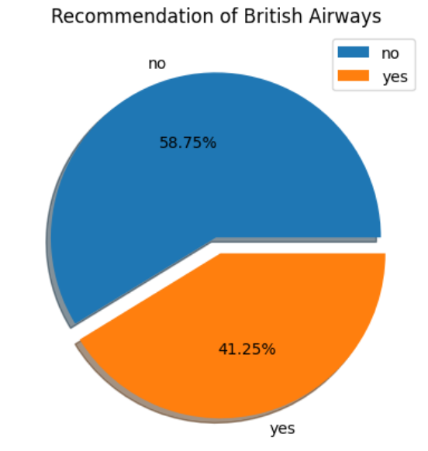
Recommendation percentage of British Airways:
41.25% people are recommending British Airways 58.75% people are not recommending British Airways

Slide 3
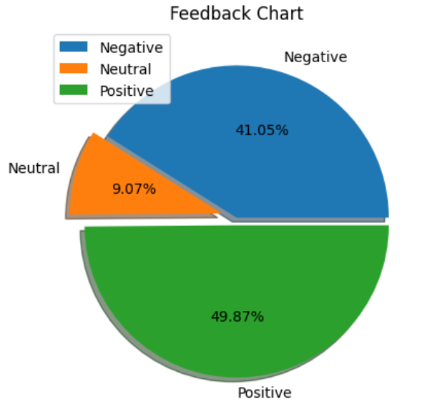
Feedback of British Airways:
49.87% Positive feedback
9.07% Neutral feedback
41.05% Negative feedback

Slide 4
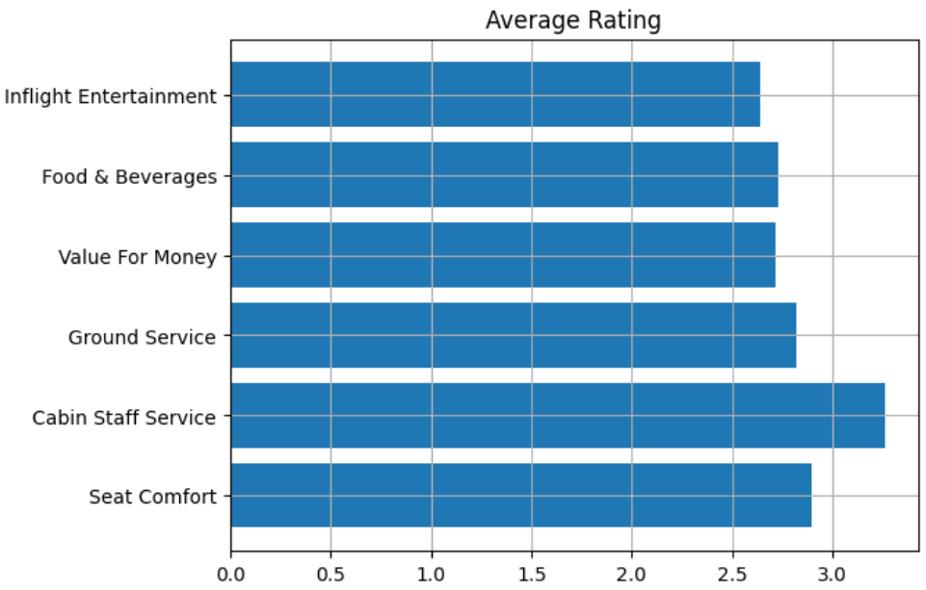
Average Rating given by Customers

Slide 5
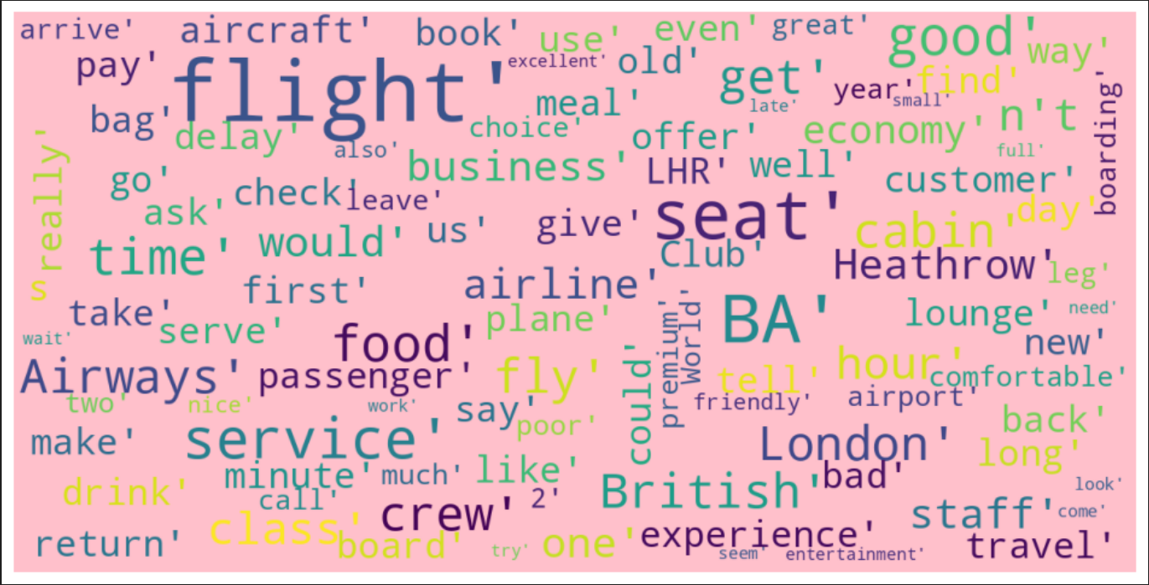
Customer Insight - Word Cloud

